Slide 1

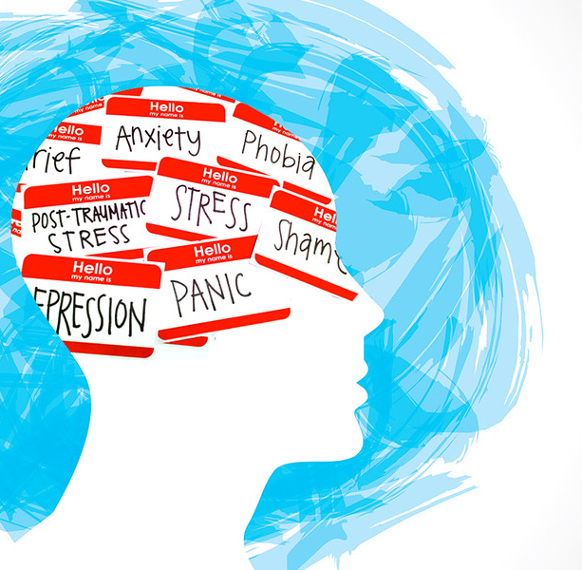

Mental Health :A Critical Component
Mental health is a vital aspect of overall well-being, yet it is often overlooked or stigmatized. This presentation aims to shed light on the importance of mental health and provide insights into the mental health landscape across Indian states.
By Team PREDATORS

Slide 2
Understanding the Context
Demographic Diversity
Mental Health Challenges
Importance of Data
India is a vast and diverse country, with significant variations in cultural, socioeconomic, and geographical factors across its states.
Mental health issues can be influenced by a range of factors, including access to healthcare, social stigma, and economic conditions.
Comprehensive data and research are crucial to understanding the mental health landscape and informing effective interventions.

Slide 3

Project Goal
1
Analyze Mental Health Trends
2
Understand Underlying Drivers
3
Inform Policy and Interventions
Examine the current state of mental health across Indian states, identifying key factors and patterns.
Explore the relationship between mental health and various socioeconomic, demographic, and geographic variables.
Provide insights that can guide policymakers and healthcare professionals in addressing mental health challenges.

Slide 4


Importance of Mental Health
Individual Well-being
Good mental health is essential for individuals to lead fulfilling and productive lives.
Community Impact
Addressing mental health issues can have a positive ripple effect on families, communities, and society as a whole.
Economic Implications
Poor mental health can lead to reduced productivity, increased healthcare costs, and economic burdens.
Holistic Approach
Integrating mental health into overall health and wellness is crucial for a comprehensive healthcare system.

Slide 5
Data Sources Used
National Mental Health Survey
Socioeconomic Indicators
Demographic Statistics
Population-level data on age, gender, and other demographic characteristics relevant to mental health.
Comprehensive data on the prevalence of mental health conditions across Indian states.
Data on factors such as income, education, and access to healthcare that can influence mental health.

Slide 6
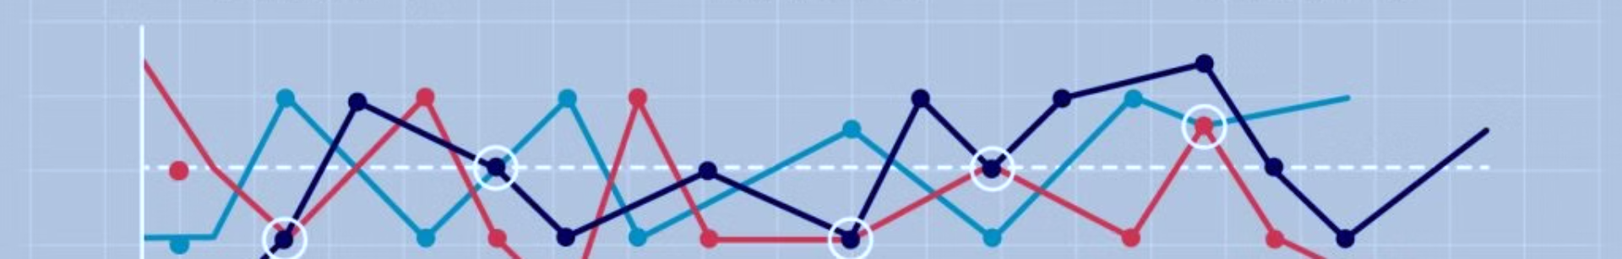
Univariate Data Insights
Prevalence Rates
Age Patterns
The data shows significant variations in the prevalence of mental health conditions across Indian states.
Mental health challenges are more common among certain age groups, like adolescents and the elderly.
1
2
3
Gender Differences
Women tend to have higher rates of certain mental health issues, such as depression and anxiety.

Slide 7
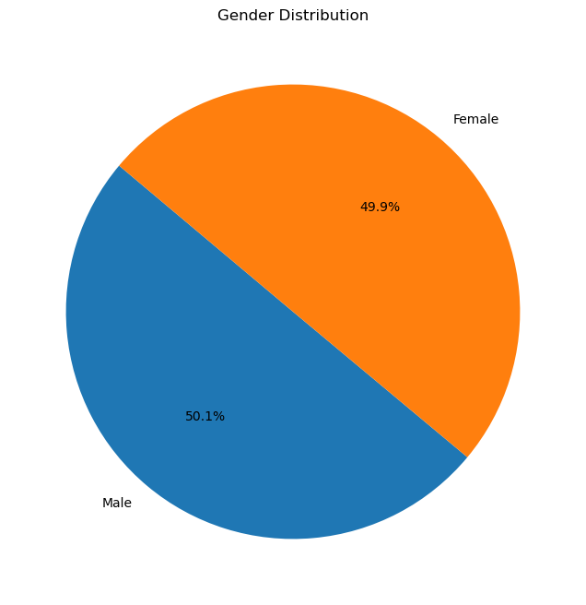
Gender Distribution
The pie chart illustrates the gender distribution in the dataset.
Male: 50.1%
Female: 49.9%
The gender distribution is almost equal, with a slight majority of males over females.
Key Points:
A balanced gender distribution indicates inclusivity and represents a diverse sample population.
This near-equal representation can be useful for ensuring unbiased analysis in subsequent research or study phases.

Slide 8
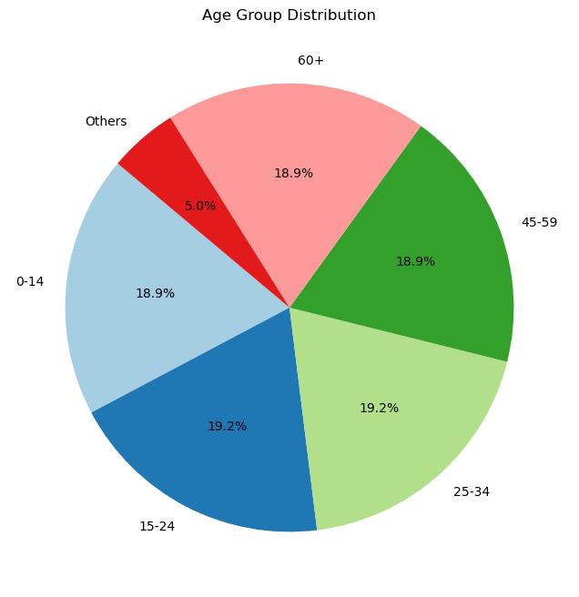
Age Group Distribution
The pie chart shows the distribution of various age groups within the dataset.
Key Points:
The age distribution is fairly even across all age groups, with each category holding a similar percentage of the population.
The "Others" category, though smaller, represents a specific group that should not be overlooked.
This diverse age representation provides a comprehensive overview of different age demographics, allowing for a nuanced analysis of data trends across different life stages.

Slide 9
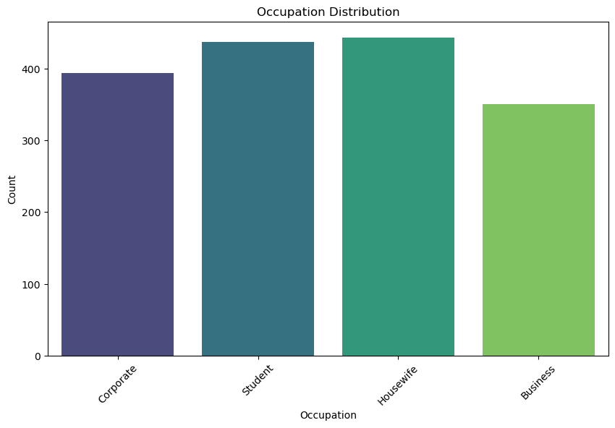
Occupation Distribution
The bar chart illustrates the distribution of different occupations among the surveyed population.
Corporate: Represents approximately 400 individuals.
Student: Represents slightly more than 450 individuals.
Housewife: Shows a similar count to students, slightly above 450 individuals.
Business: Represents around 350 individuals.
Insights:
The data indicates a relatively balanced distribution among the first three occupations.
Business occupation is less represented compared to the other three categories.

Slide 10
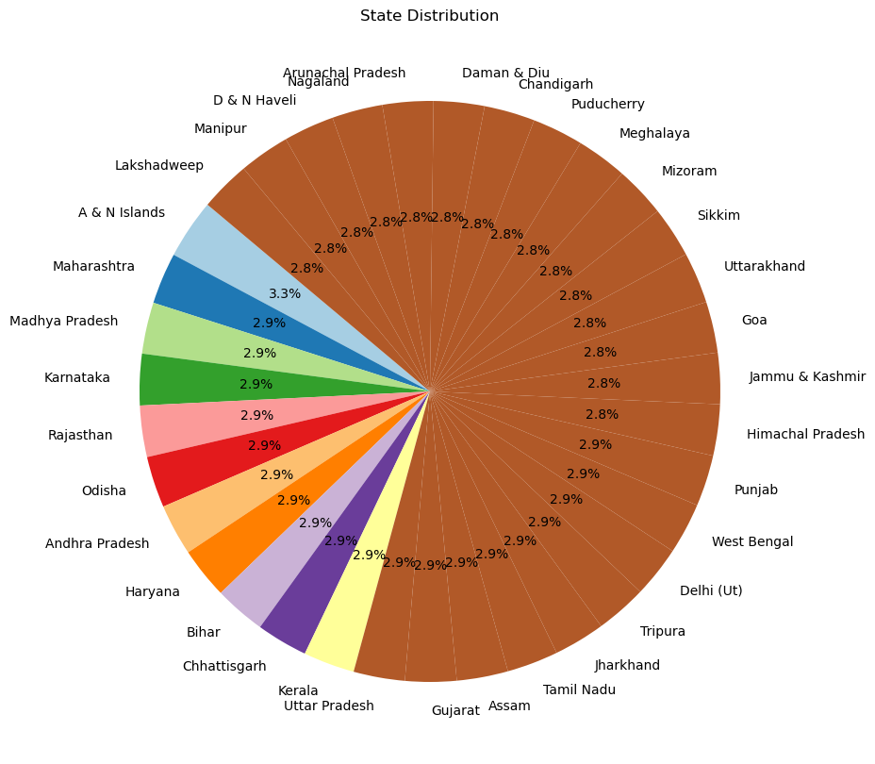
State Distribution
The pie chart visualizes the distribution of participants across various states.
Top States: Madhya Pradesh: Represents the highest percentage at 3.3%.
Maharashtra, Karnataka, Rajasthan, Odisha, Andhra Pradesh, Haryana, Bihar, Chhattisgarh, Kerala, Uttar Pradesh: Each state represents around 2.9%.
Other States: Include a wide range of states, each contributing approximately 2.8% to the total distribution.
Insights: The distribution is fairly even across most states, indicating a diverse geographic representation. No single state dominates the participant pool, ensuring a wide range of perspectives.

Slide 11
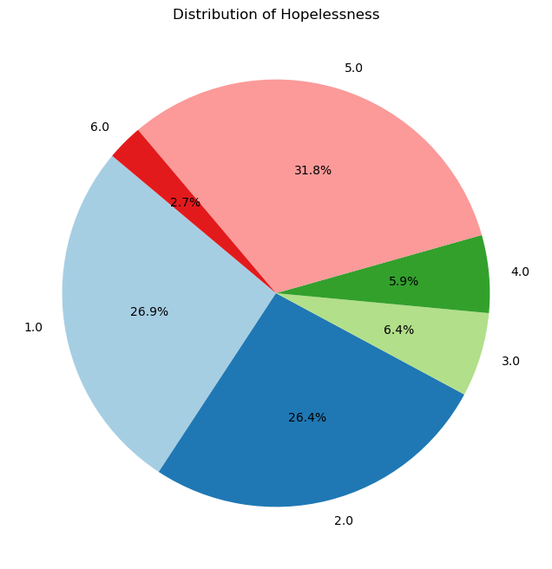
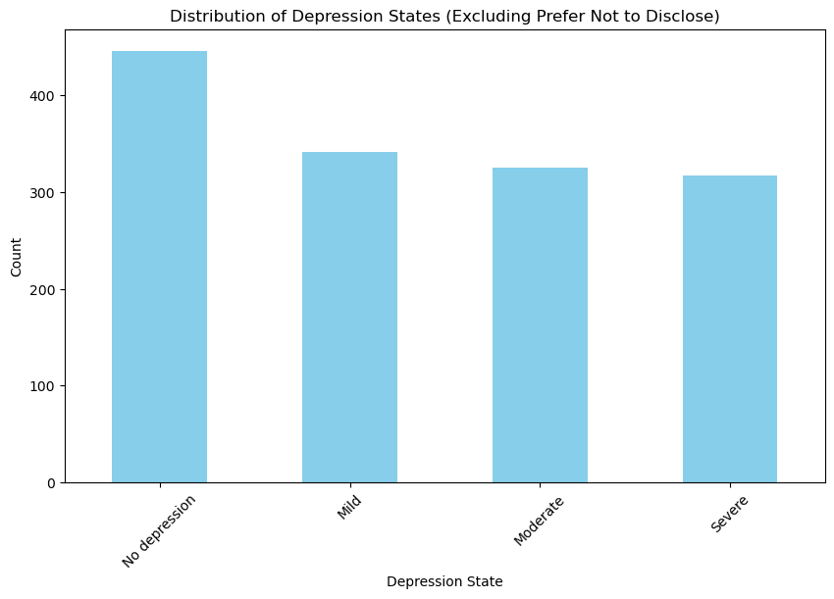
Mental health stats

Slide 12
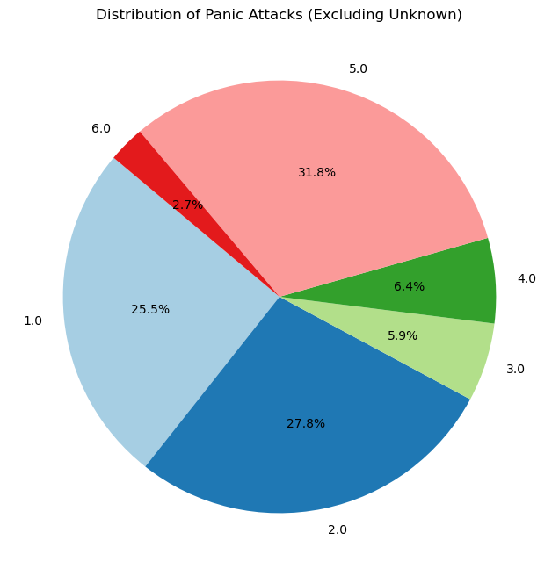


Slide 13
Multivariate Data Exploration
Socioeconomic Factors
Demographic Trends
Regional Disparities
Poverty, education levels, and access to healthcare are found to be significant predictors of mental health outcomes.
Factors like urbanization, population density, and the proportion of marginalized communities influence mental health prevalence.
Geographical and cultural differences contribute to the uneven distribution of mental health resources and support across Indian states.

Slide 14
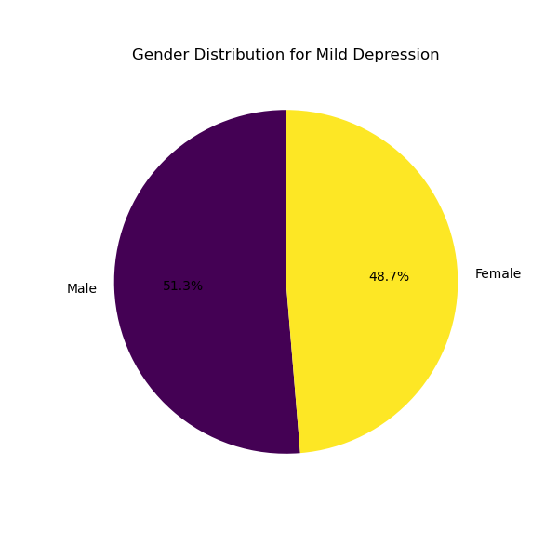
Gender Distribution (Mild)
Among those with mild depression, 51.3% are female, with the remaining 48.7% being male.

Slide 15
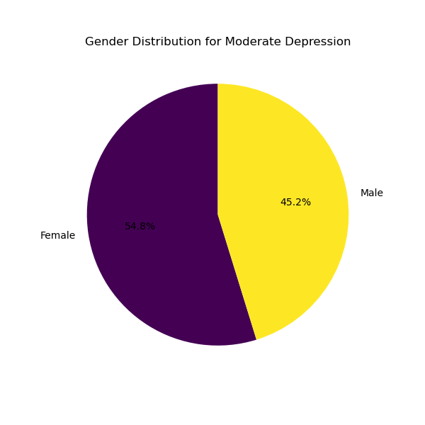
Gender Distribution (Moderate)
Among those with moderate depression, 54.8% are female, with the remaining 45.2% being male.

Slide 16
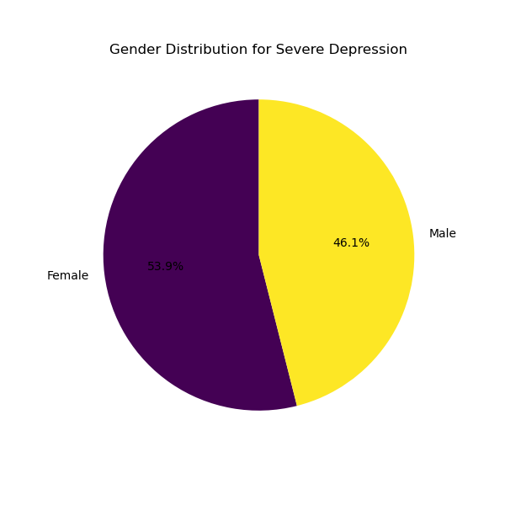
Gender Distribution (Severe)
Among those with no depression, 53.9% are female, with the remaining 46.1% being male.

Slide 17
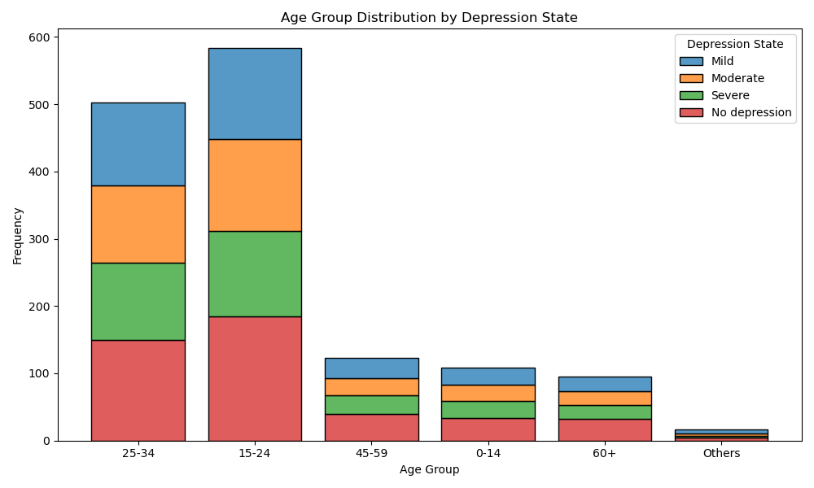
Age Group Distribution
The 15-24 and 25-34 age groups have the highest overall frequencies of depression.
Mild depression is most common in the 15-24 age group.
The 60+ age group has the lowest frequency of depression across all states.
No depression (healthy state) is most prevalent in the 15-24 age group, followed closely by 25-34.

Slide 18
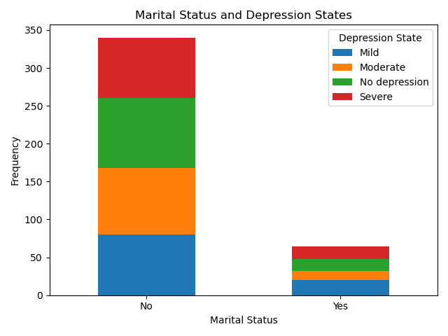
Marrital Status & Depression
Unmarried individuals ("No" marital status) have a much higher frequency of depression across all severity levels compared to married individuals.
The most common depression state for both married and unmarried groups is moderate depression.
Severe depression appears to be more prevalent among unmarried individuals..

Slide 19
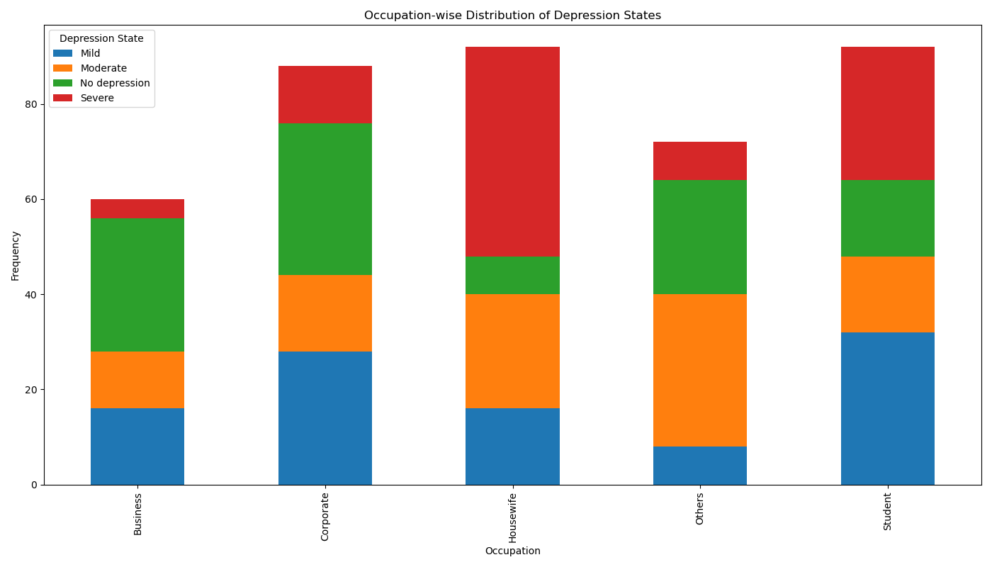
Occupation Distribution
Students have the highest frequency of mild depression among all occupations.
Housewives show the highest proportion of severe depression cases.
The business sector has the highest percentage of individuals with no depression.
Corporate employees have a relatively balanced distribution across depression states.

Slide 20
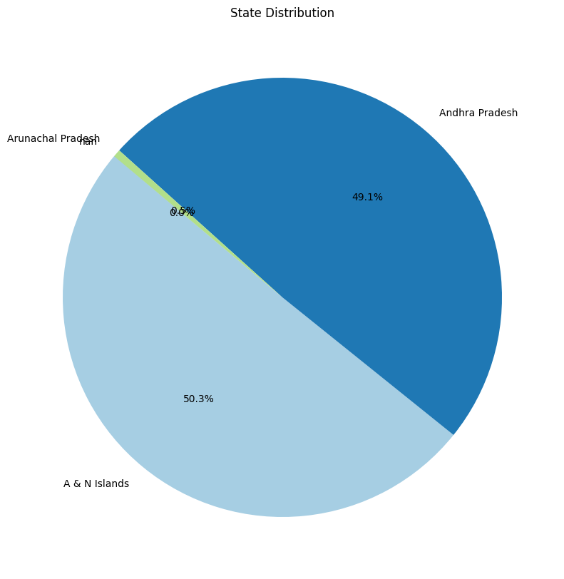
State Distribution
A & N Islands has the largest share at 50.3% of the distribution.
Andhra Pradesh follows closely with 49.1%.
Arunachal Pradesh has a very small representation at 0.5%.

Slide 21
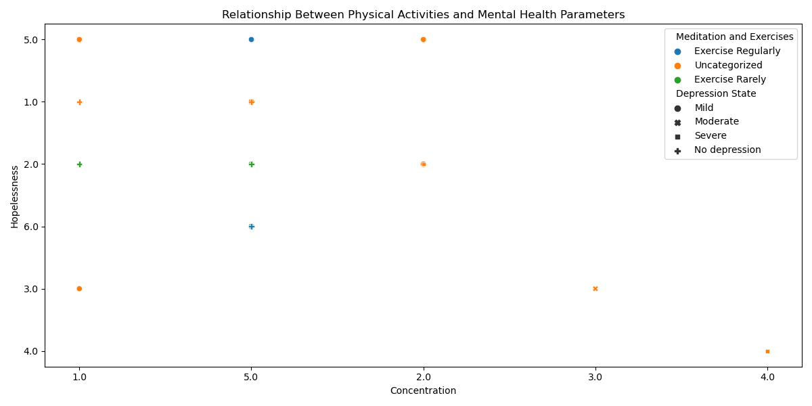
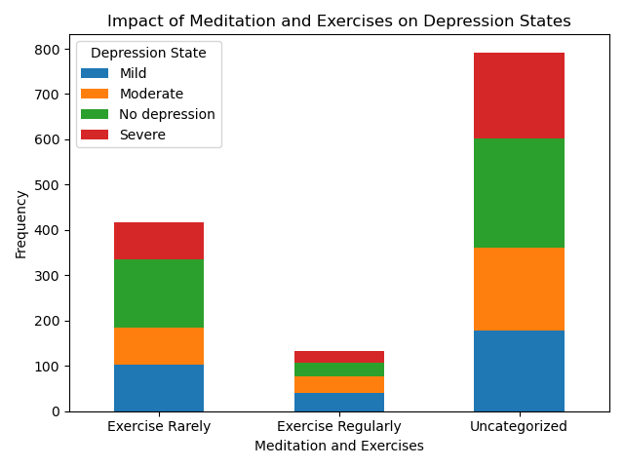
Meditation and Exercises
Gender Distribution
Highlighting Trends
The data shows a clear breakdown of the gender distribution, providing valuable insights into the demographics of the dataset.
The charts and graphs effectively highlight the important trends and patterns within the dataset, allowing for a more thorough understanding of the univariate characteristics.

Slide 22
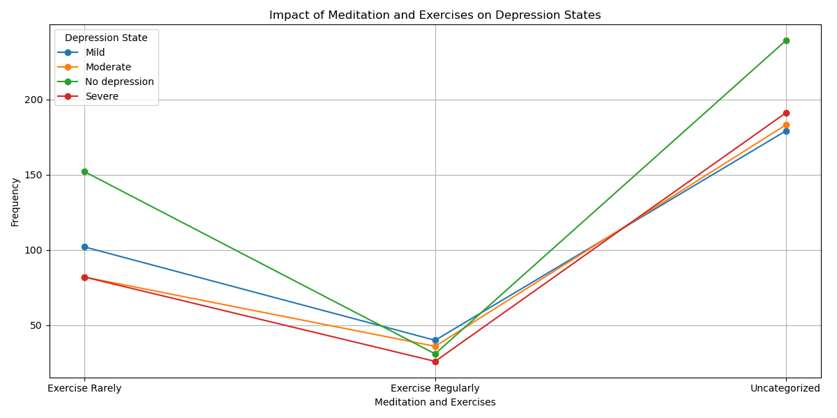
Meditation and Exercises (Line)
The "Uncategorized" group has the highest frequency across all depression states.
Those who "Exercise Rarely" show higher frequencies of depression compared to those who "Exercise Regularly".
Regular exercise appears to be associated with lower frequencies of severe and moderate depression.

Slide 23
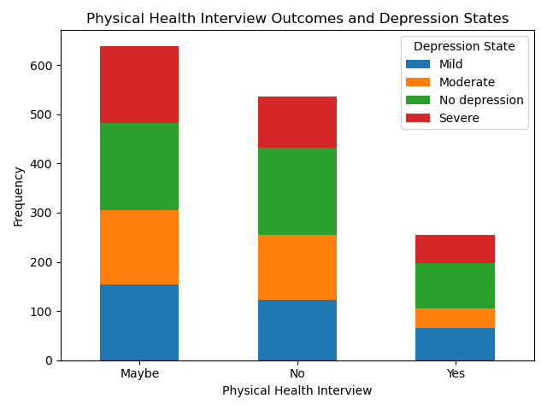
Physical Health Interview Outcomes
The "Maybe" category has the highest overall frequency of responses.
For all interview outcomes, moderate depression is the most common state.
The "Yes" category has the lowest frequency of severe depression cases.

Slide 24
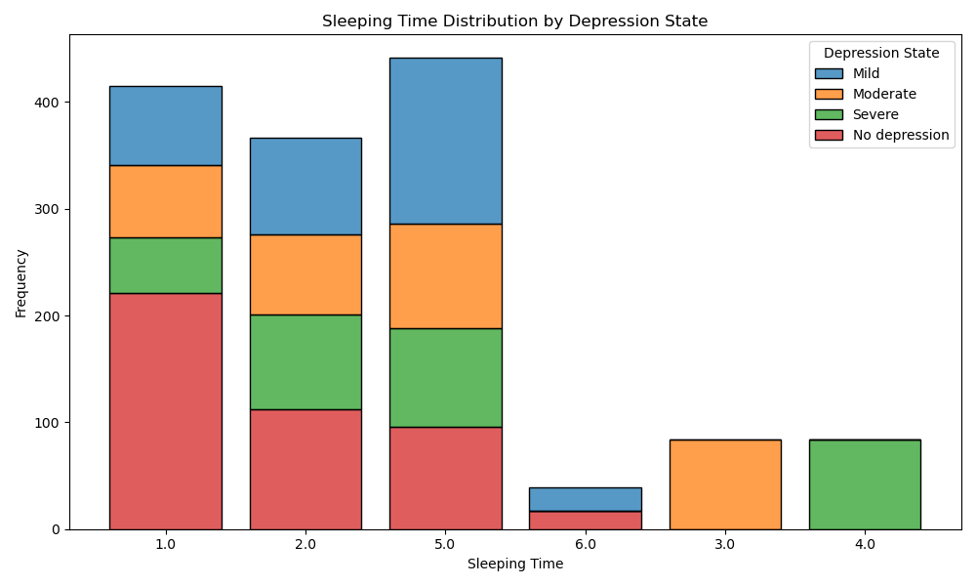
Sleeping Time
Bimodal distribution for most depression states, with peaks around 2.5 and 6 hours of sleep.
The "No depression" state (likely green) shows the highest peak at around 6-7 hours of sleep.
Severe depression (likely red) shows a higher proportion of short sleep durations.

Slide 25
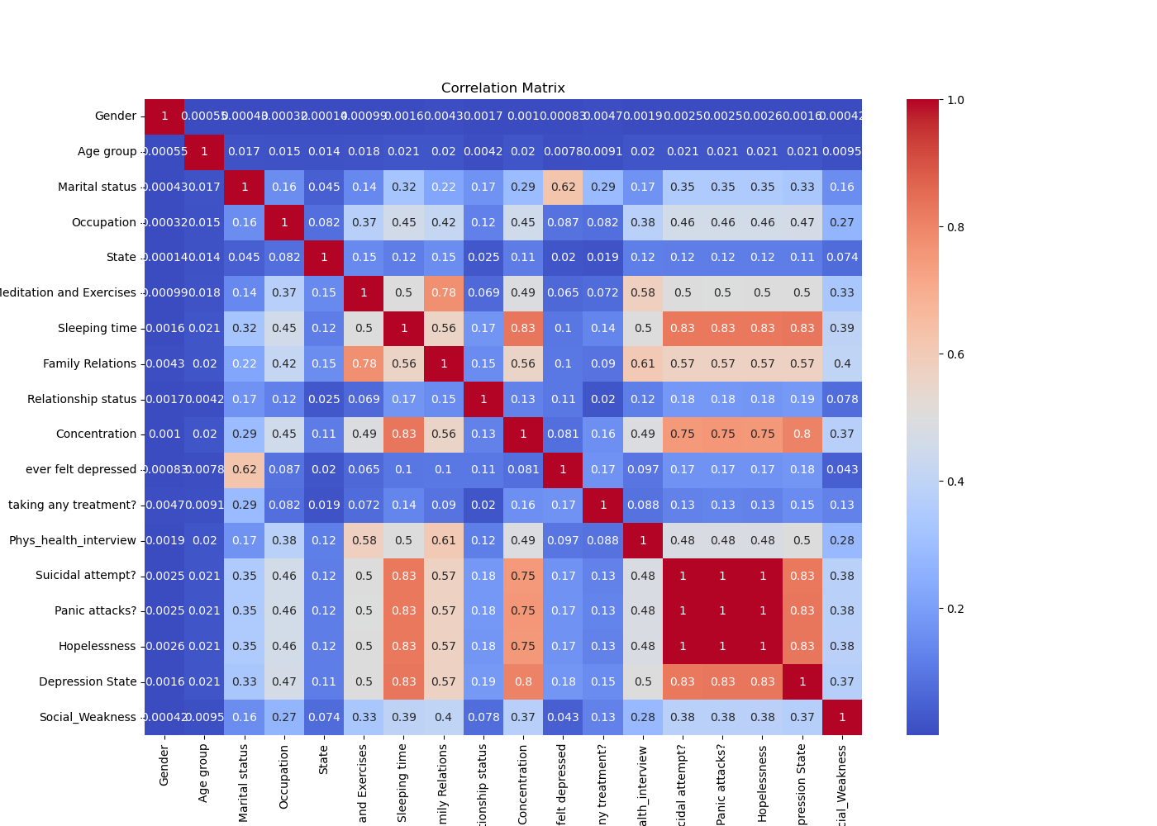
Relationship Status Distribution
Strong positive correlations (dark red) between suicidal attempt, panic attacks, and hopelessness (all 1.0).
Moderate positive correlation (0.83) between sleeping time and concentration.
Generally weak correlations between gender and other variables (mostly blue).

Slide 26
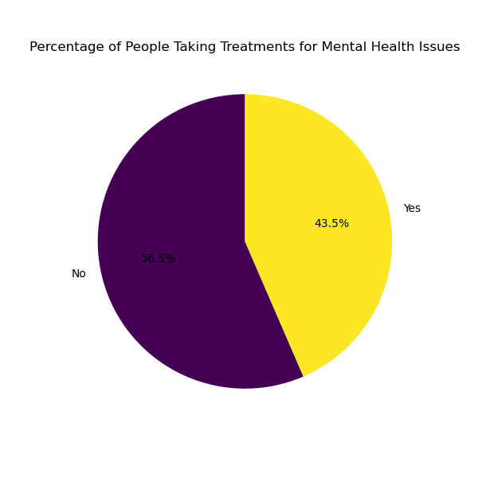
Taking Any Treatment
56.5% of people are not taking treatments for mental health issues.
43.5% of people are taking treatments for mental health issues.
The majority, though not by a large margin, are not seeking treatment.

Slide 27

Predictive Modeling
Machine Learning Algorithms
1
Advanced statistical and machine learning techniques were employed to develop predictive models for mental health outcomes.
2
Feature Importance
The analysis identified the most influential factors, such as income, education, and access to healthcare, in determining mental health status.
Model Evaluation
3
The predictive models were validated using various performance metrics to ensure their reliability and accuracy.

Slide 28
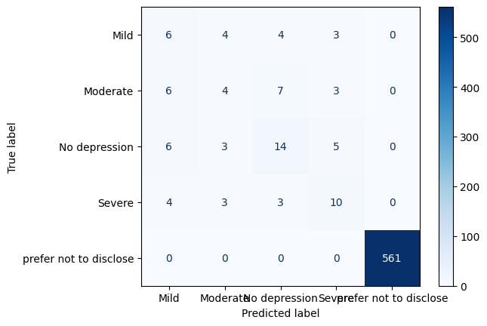
CONFUSION MATRIX
The "prefer not to disclose" class has perfect classification (561 correct predictions).
There's significant misclassification among the other depression states.
"No depression" is most often correctly classified among the depression states (14 correct predictions).

Slide 29
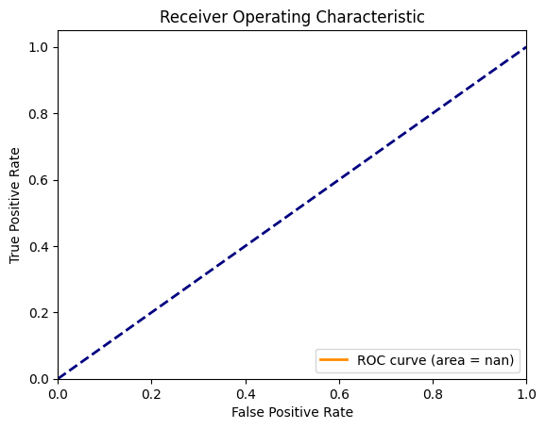
receiver operating characteristic
The ROC curve is a straight diagonal line from (0,0) to (1,1).
This indicates that the classifier's performance is no better than random guessing.
The area under the ROC curve (AUC) is not available (nan), which is unusual and may indicate an error in the calculation or data.

Slide 30
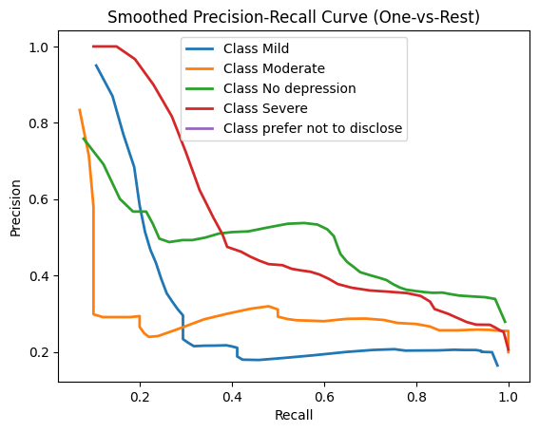
precision-recall curve (smoothed)
"Class Severe" maintains high precision at low recall values.
"Class No depression" shows more stable precision across different recall values.
"Class Mild" and "Class Moderate" have generally lower precision, especially at higher recall values.

Slide 31
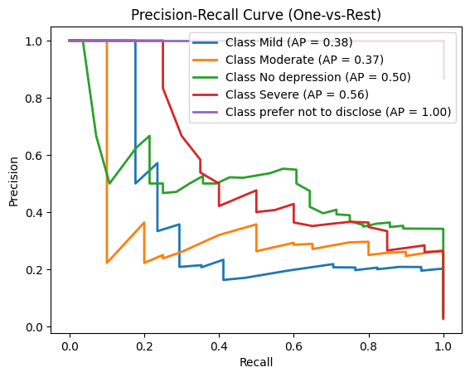
Precision-recall curve
"Class prefer not to disclose" has the highest average precision (AP) of 1.00.
"Class Severe" has the second-highest AP at 0.56.
"Class Mild" and "Class Moderate" have similar, lower APs (0.38 and 0.37 respectively).

Slide 32




Visualization Highlights
Spatial Patterns
Geospatial visualizations reveal the uneven distribution of mental health resources and outcomes across Indian states.
Variable Relationships
Interactive scatter plots and correlation matrices highlight the complex interplay between mental health and various socioeconomic factors.
Temporal Trends
Line graphs and time series analyses showcase the evolving mental health landscape over time, identifying patterns and emerging issues.

Slide 33




Summary of Findings
Key Insights
The analysis reveals significant disparities in mental health across Indian states, with socioeconomic and demographic factors playing a crucial role.
Policy Implications
The findings can inform the development of targeted interventions and policies to address mental health challenges, promote equity, and improve overall well-being.
Future Directions
Ongoing research and data-driven approaches are essential to continuously monitor and address the evolving mental health landscape in India.

